Slide 1










Airline Overbooking Optimization
Minimizing Airline Losses with Bayesian Inference and Monte Carlo Estimators
Mentor: Dr. Dhrubasish Bhattacharyya
Members :
Prince (22mc3039) | Shaunak (22mc3029)

Slide 2
Introduction
Airline overbooking is a common strategy for :
.
Revenue Maximization:
Offset no-show losses by maximizing seat sales.
1
Optimal Balance:
Balancing revenue with customer satisfaction.
2
Customer Dissatisfaction:
Risk of denied boarding and compensation costs
3
*”no-show” refers to a customer who booked a reservation but failed to show up

Slide 3
Problem Statement
Current Scenario:
Airlines struggle to predict no-show rates accurately.
Overbooking often relies on historical averages without real-time adjustments.
Key Objective:
To develop a data-driven approach using Bayesian inference and Monte Carlo methods.
No-Shows | Overbooking | Impact
High | Low | Lost revenue
Low | High | Denied boarding, compensation

Slide 4
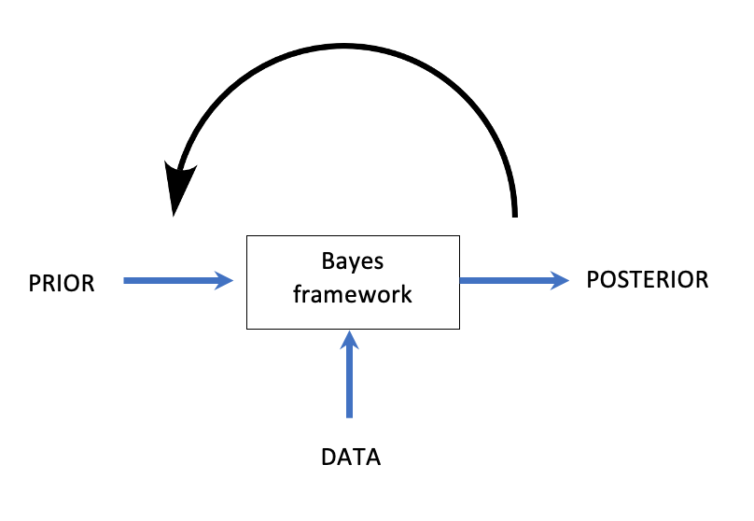
Bayesian Framework
Bayesian Benefits:
Adaptability to new data.
Quantifies uncertainty in predictions.
Understanding Bayesian Inference:
Prior: Historical knowledge about no-show rates.
Likelihood: Current observations (e.g., recent booking trends).
Posterior: Updated probability distribution based on prior and likelihood.

Slide 5
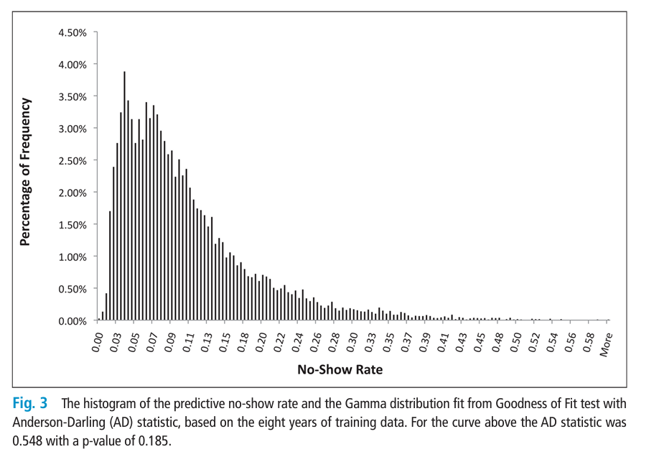
Prior Distribution
p(θ)=Gamma(α,β)
θ: no-show rate
Based on past 8 years of observed data, the following shows the proability distribution of no-show rate.
1. The Anderson-Darling (AD) test statistic supports the fit with a p-value of 0.185, indicating the Gamma distribution is an acceptable model for the given data.
2. The parameters of the gamma distribution are represented as alpha (α) and beta (β):
Alpha (α): The shape parameter =1.803
Beta (β): The rate parameter, which is the reciprocal of the scale parameter = 0.1099
3. From this, we can infer that the mode no-show rate is approximate to 0.05 and mean is 0.195270
Source: Y. Huang1; D.A. Hanauer2
DOI:10.4338/ACI-2014-04-RA-0026
No-Show Predictive Model
Development using Multiple Data
Sources for an Effective Overbooking
Approach

Slide 6
Likelihood
As there is a lack of real-world observations, we have simulated passenger showups using reasonable assumptions.
Parameters to Simulate Likelihood:
Number of flights: n = 500
Tickets sold per flight: M = 400
Simulation step:
Draw a no-show rate 𝑝 from the Gamma prior distribution.
Simulate the number of passengers who showed up using np.random.binomial (M, 1-p).
np.random.binomial() is a function in NumPy that generates random numbers from a binomial distribution.
For each flight, the number of passengers showing up is modeled using a Binomial distribution:
X~ Binomial(M,1-p), (p = no-show rate)
This provides synthetic likelihood data: the number of passengers who showed up for each flight.

Slide 7
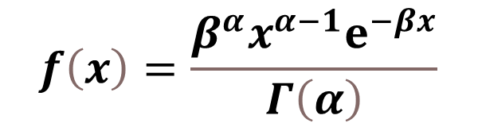
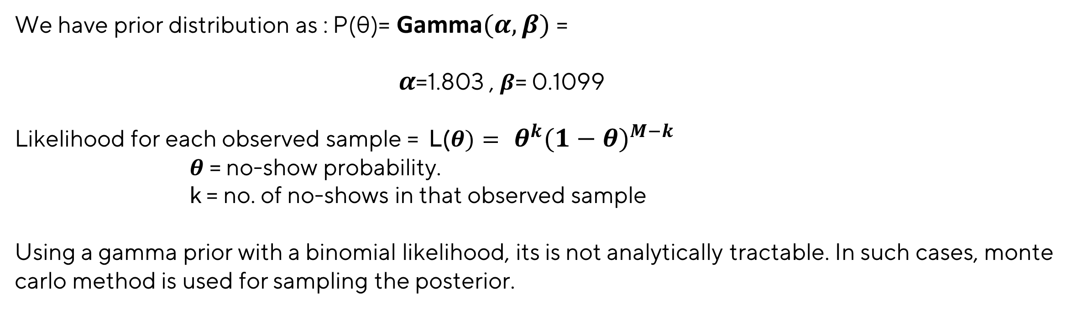
Posterior Distribution
From Baye’s Theorem :
P(θ|data) ∝ P(data|θ) . P(θ )
Likelihood P(data ∣ θ) : The probability of observing the data given the parameter θ.
Prior P(θ): The prior belief about the parameter θ before observing the data.
Posterior P(θ ∣ data): Updated belief about θ after incorporating the data.
$$f\left(x\right)=\frac{β^{α}x^{α−1}ⅇ^{−βx}}{Γ\left(α\right)}$$
We have prior distribution as : P(θ)= Gamma$(α,β)$ =
$α$=1.803 , $β$= 0.1099
Likelihood for each observed sample = L($θ)=$ $θ^{k}{(1−θ)}^{M−k}$
$θ$ = no-show probability.
k = no. of no-shows in that observed sample
Using a gamma prior with a binomial likelihood, its is not analytically tractable. In such cases, monte carlo method is used for sampling the posterior.

Slide 8
Monte Carlo Estimation
What is Monte Carlo Simulation?
A computational technique for approximating outcomes by repeated random sampling.
Role in Bayesian Analysis:
Handles complex posterior distributions that cannot be computed analytically.
Process Steps :
STEP 1
STEP 2
STEP 3
Historical data from the prior distribution.
Combine historical belifes with the likelihood to compute the posterior.
Use the posterior to estimate optimal booking limits.

Slide 9
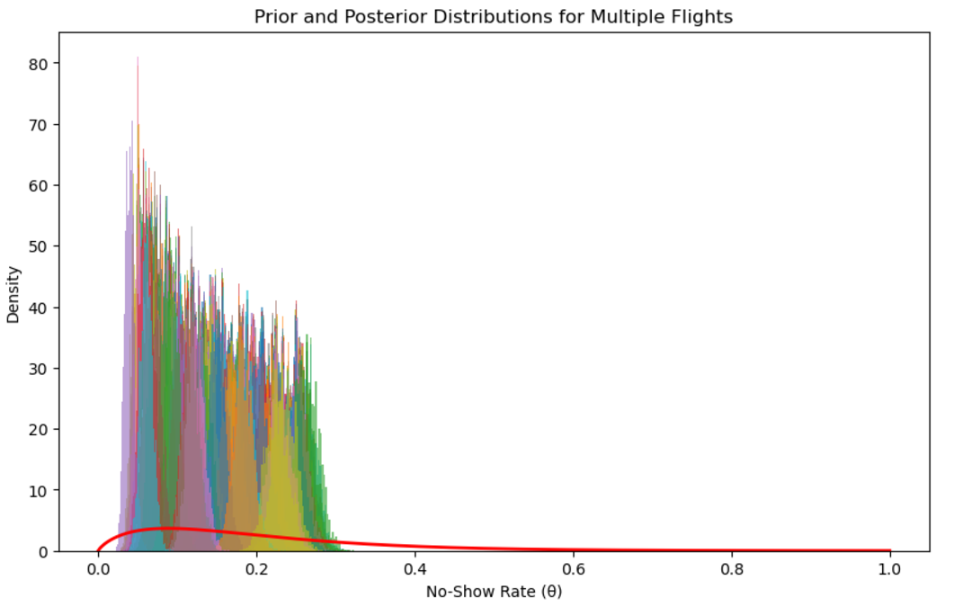

Results :
The red line represents the prior probability distribution of no-show rates.
Every unique colour represents the posterior probability distribution of no-show rates after observing the corresponding data for each flight.

Slide 10

Conclusion :
The peak (mode) of most posterior distributions appears to be around 0.1.
The distributions are skewed slightly to the right, meaning the mean will be slightly higher than the mode.
Simulations suggest that a 12-15% overbooking rate aligns with the expected no-show behavior.
By overbooking flights within the 12-15% range, airlines can fill seats that would otherwise remain vacant due to no-shows.
Overbooking beyond 15% increases the risk of overcompensating, leading to passenger denial and associated costs (e.g., refunds, rebooking, penalties).
Staying within 12-15% balances the likelihood of no-shows and minimizes passenger dissatisfaction.
Overbooking within the optimal range reduces the risk of customer frustration caused by denied boarding.

Slide 11


